Slide 1

One Digit Classification
Omar Hassan – Jamil Hamed – Feras Amro
Supervised By Dr. Mohammed Elbes

Slide 2
One Digit Classification
Beginning of all, our project is based on classifying data consisting of one digit examples, and that’s the reason behind the project’s name.
Classification is a supervised form of learning, where you teach the computer to do something with data that's already labeled by humans. In our case we are teaching the computer/model to classify or predict the one digit number based on its index.
We used MNIST dataset from TensorFlow/keras which is database of handwritten digits, available from this page, has a training set of 60,000 examples, and a test set of 10,000 examples. It is a subset of a larger set available from NIST. The digits have been size-normalized and centered in a fixed-size image.

Slide 3
Code Analyzation
Code
print(f'training_images: {training_images.shape}') # Number of pixels print(f'training_labels: {training_labels.shape}') # Number of pixels print(f'test_images: {test_images.shape}') # Number of pixels
print(f'test_labels: {test_labels.shape}') # Number of pixels
Here we can see number
of
photos and size of it:

Slide 4
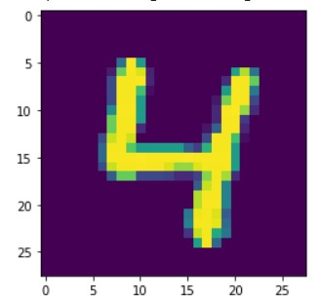
Code Analyzation
Displaying the photo using matplotlib library:
Code
We chose randomly image number 56 (with index 56):
plt.imshow(test_images[56])
As Seen in the picture below
Output :

Slide 5
Code Analyzation
In the grayscale mode we have only one layer, each pixel in it has value (0 - 255) so to convert it into (0 - 1) we use the following statement:
Code
training_images = training_images / 255.0 ## لتحويل القيم بين الصفر والواحد

Slide 6
Building The Model
Steps:
firstly to build model in tensorflow we use this statement:
model = tf.keras.models.Sequential()
Then we add to it the layers or we can embed it inside 'Sequential(..)' in one statement..
First layer will be the input layer from the type Conv2D (its the layer used to input matrixes(image) data:
[tf.keras.layers.Conv2D(filters=32, kernel_size=(3,3), activation='relu', input_shape=(28,28,1)),
Activation function(decide iof neuron is important or not)
Secondly we add the pooling (select highest value from pixels each 'square drawn virtually' into the model and add them as a new smaller size image:
tf.keras.layers.MaxPooling2D((2,2)), # pooling (highest pixel in selected square & take its value..)

Slide 7
Building The Model Continue
Then we add the flatten layer which convert matrix into one dimension:
tf.keras.layers.Flatten(), # multi-dimensional tensors to single dimension.
After that adding DL (NN) hidden layer with (128) neuron, and Activation function 'relu’:
tf.keras.layers.Dense(128, activation='relu'), # deep connected NN layer (HL)
Lastly adding the output layer with 10 neurons because we have 10 predictions classes (digits 0-9):
tf.keras.layers.Dense(10, activation=tf.nn.softmax)]

Slide 8
Code Analyzation
Scalar value (error) that we attempt to minimize during our training of the model.
sparse_categorical_crossentropy: Training a neural network involves passing data forward, through the model, and comparing predictions with ground truth labels:
model.compile(optimizer = 'adam', # AI Algorithm used
loss = 'sparse_categorical_crossentropy',
metrics=['accuracy'])
# shown variable during each epoch in model training.
Now start training the model with 50 epochs that means reread the training data 50 times:
model.fit(training_images, training_labels, epochs=50)
Finding accuracy of testing:
model.evaluate(test_images, test_labels)

Slide 9
Model Prediction
<< predicting selected photo`s class, argmax >>
return max element of the array:
print(np.argmax(model.predict(test_images)[56]))

Slide 10
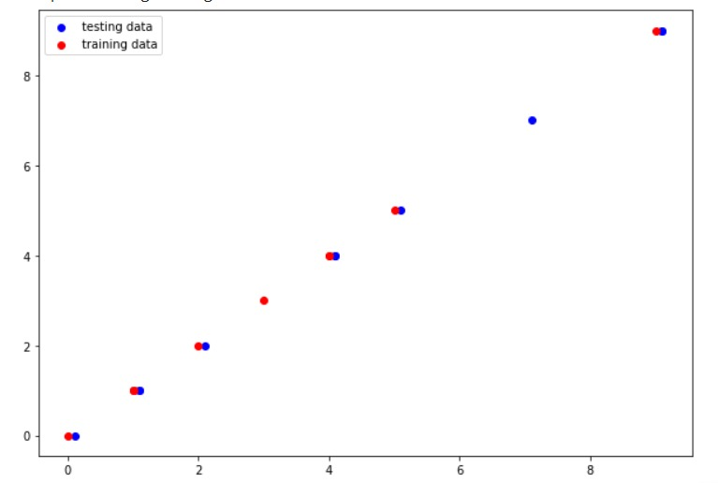
Visualizing Results
Code
labels_test = []labels_train = []for i in range(10): labels_test.append(np.argmax(model.predict(test_images)[i])) labels_train.append(np.argmax(model.predict(training_images)[i]))print(f'Testing: {labels_test}')print(f'Training: {labels_train}')plt.figure(figsize=(10,7))plt.scatter(test_labels[:10]+0.1, labels_test , c='b', label="testing data")# print(training_labels[:10])# print(labels_train)plt.scatter(training_labels[:10], labels_train , c='r', label="training data")plt.legend()

Slide 11
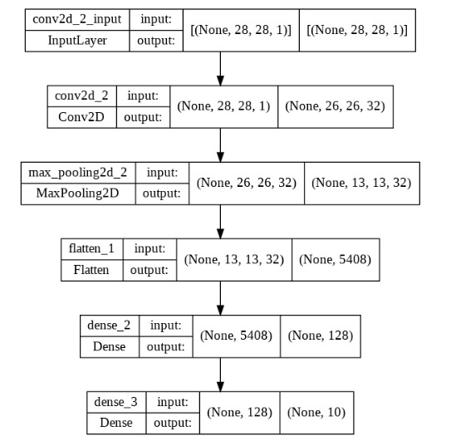
Visualizing Results
Code:
tf.keras.utils.plot_model(model, show_shapes=True)

Slide 12
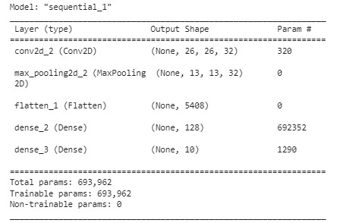
Summary
model.summary()

Slide 13
Thank You

